Slide 1

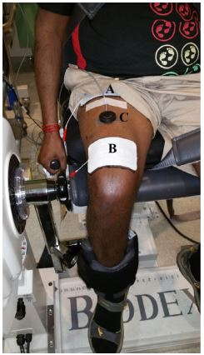
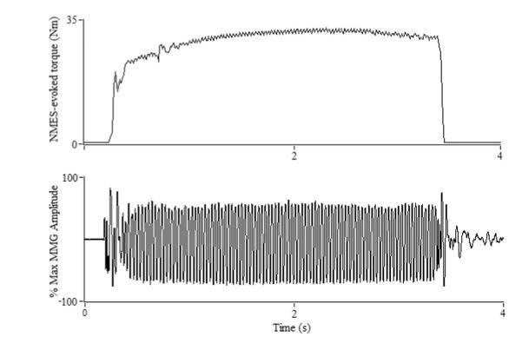
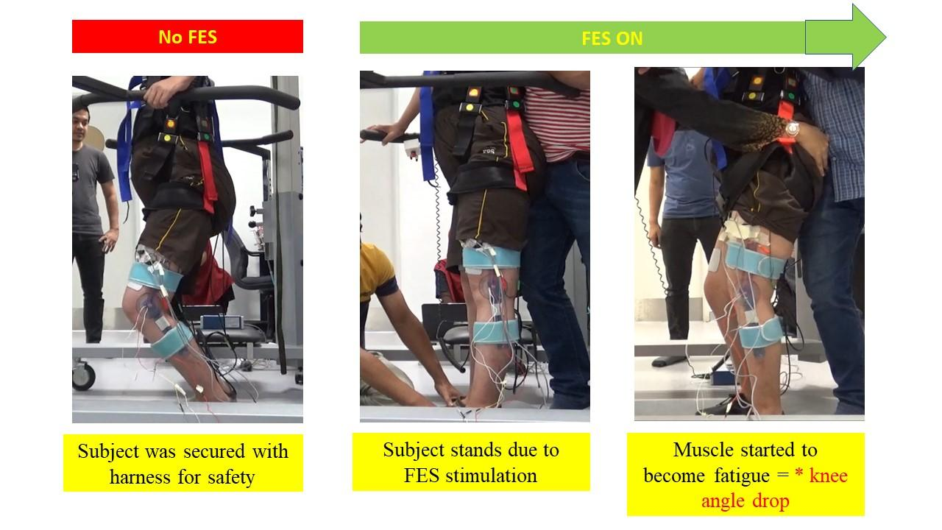
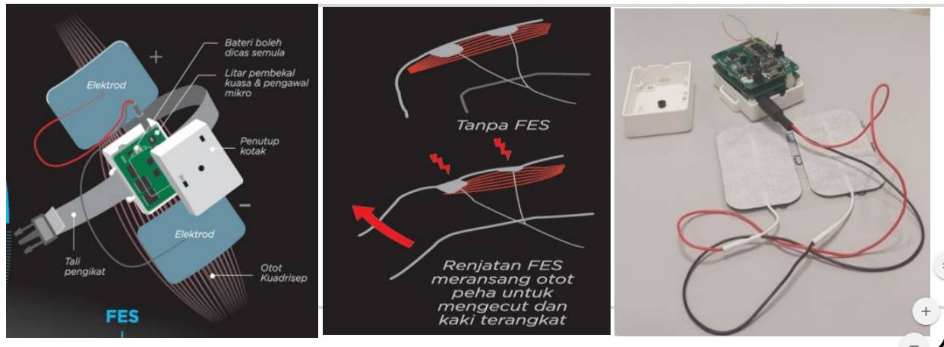
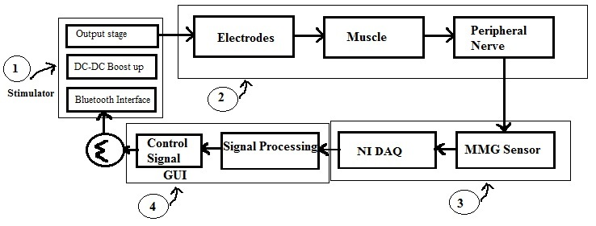
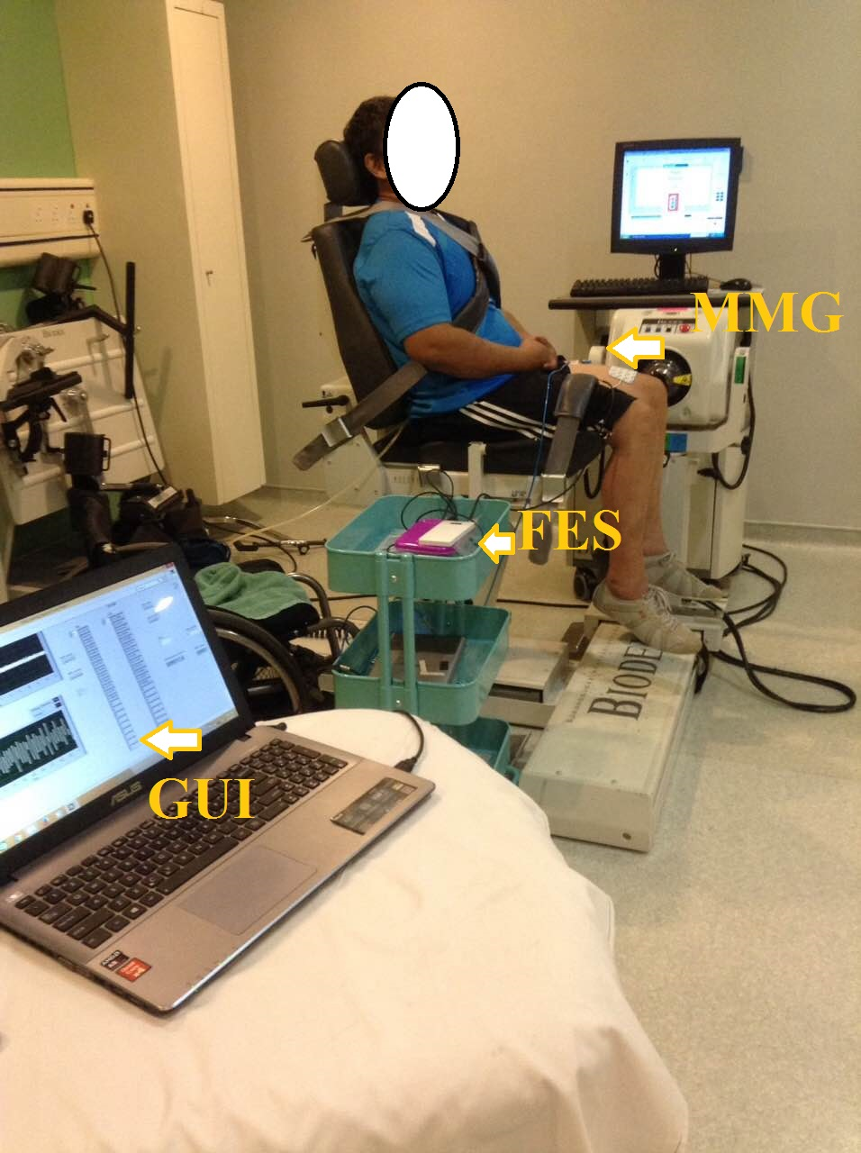

Institutional/University Logo:
Title & Affiliation: Mechanomyography based-Muscle Feedback Functional Electrical Stimulator (FES)
Introduction
Result/Analysis
Location of MMG sensor and FES electrodes
FES evoked muscle contraction (above) reflected by the MMG amplitude (below)
Methodology/Design
FES evoked muscle contraction will gradually cause muscle fatigue seen by increasing knee drop.
At a certain point, torque produced around the knee joint by the FES are unable to maintain standing.
Having MMG as the muscle sensor to feedback muscle state allows optimized and prolonged standing session for clinical benefit.
Design of FES
Evoked Muscle contraction
Prototype FES device
Conclusion
The FES receive MMG input from the muscle to control the intensity of the stimulation
Project Leader
Acknowledgement/Reference
Team members:

