Slide 1
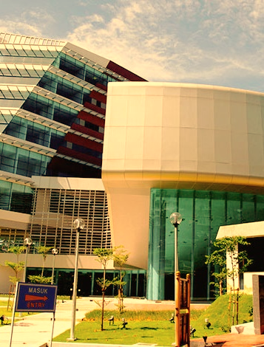
Slide title
UNIVERSITY OF MALAYA ACADEMIA COMMUNITY ENGAGEMENT INTERNATIONAL CONFERENCE 2019
A conference by:
Organized by:

